Slide 1
Image Processing Project3
2019-05-21

Slide 2
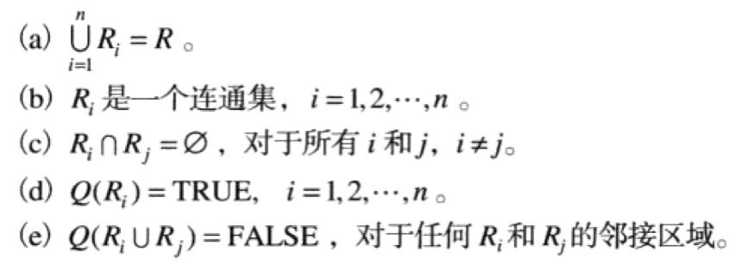
Image Segmentation:
Let R denote the entire spatial region occupied by an image, and divide the image into a process of dividing R into n sub-regions R1, R2, …, Rn, satisfying:

Slide 3
Image Segmentation: for monochrome images, one of two fundamental properties based on gray values: discontinuity and similarity.
The first sort: the boundary of the region is completely different from each other and different from the background, allowing boundary detection based on local discontinuity of grayscale.
The second sort: Split an image into similar regions according to a predefined set of criteria.

Slide 4
Edge detection: is simply a case of trying to find the regions in an image where we have a sharp change in intensity or a sharp change in color, a high value indicates a steep change and a low value indicates a shallow change.
Edge detection is the most common method for segmenting images based on grayscale mutations.
Sobel:
Robert:
Prewitt:
Laplacian:
Canny:

Slide 5
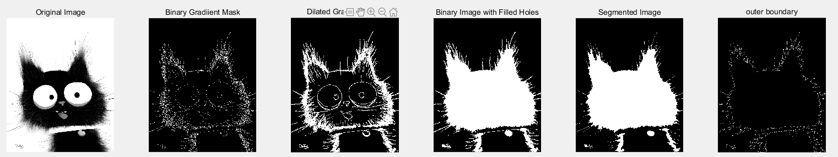
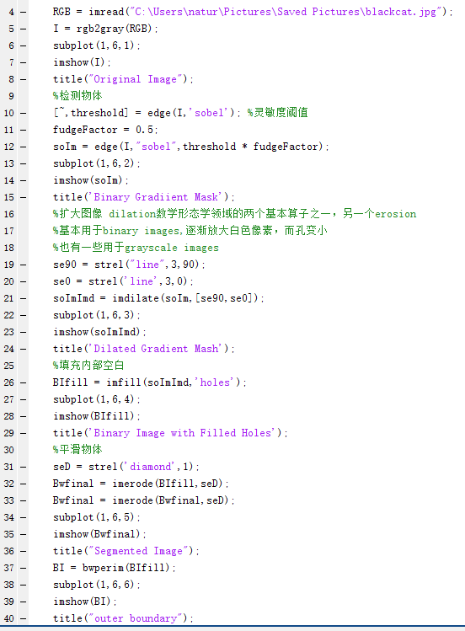
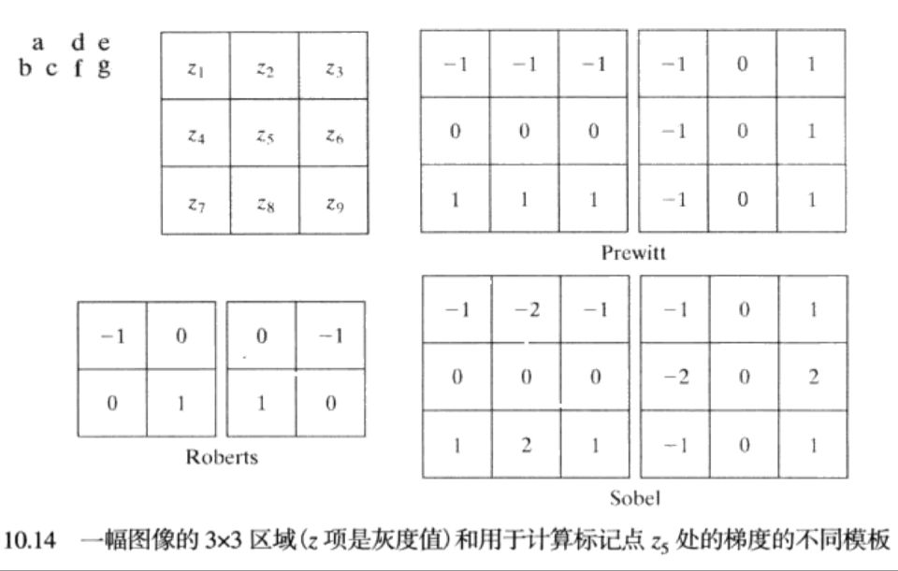
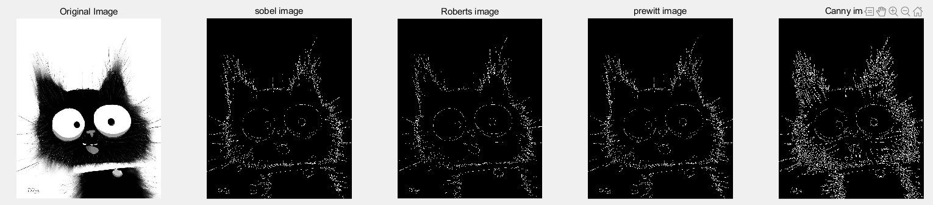
Sobel/Prewitt/Roberts: Noise pollution is not excluded, edge lines are too thick and wide, etc.
BW = edge(I , 'sobel’);
BW = edge(I , ‘Prewitt');
BW = edge(I , ‘Roberts');

Slide 6
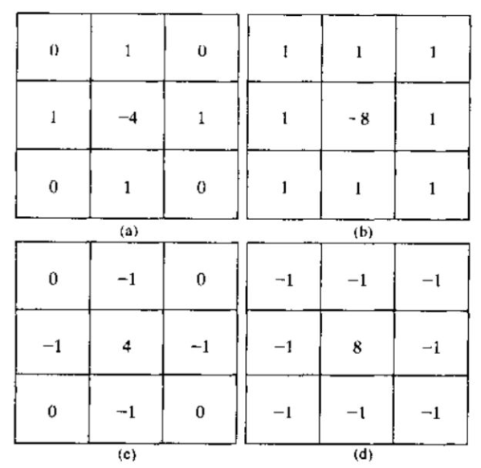

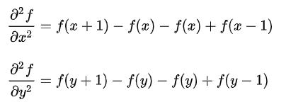
Laplacian:
The filter of a is a 90° rotation isotropic result
b's filter is a 45° rotation isotropic result
Both c and d are extensions of the above two
It can highlight isolated points, isolated lines, or line endpoints in an image.

Slide 7
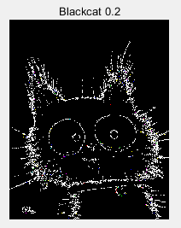
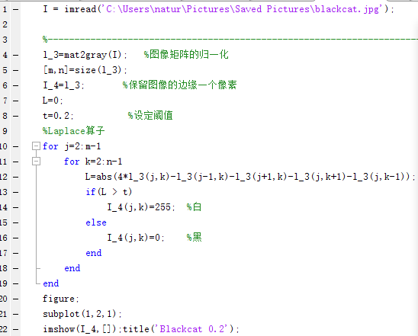
Laplacian:

Slide 8
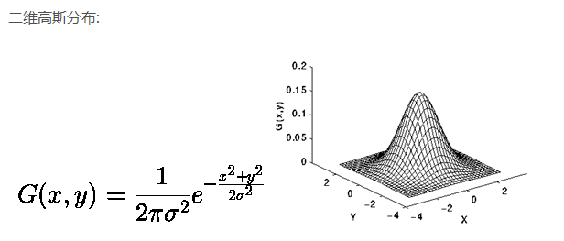
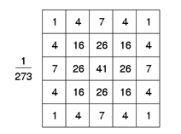
Canny:
2. Calculate the gradient image and the angle image:
the angle image provides guidance for the direction of non-maximum suppression.
3. Non-maximum suppression of gradient images:
Set the gray value corresponding to the non-maximum value to 0, and eliminate a large number of non-edge pixel points, After the non-maximum suppression, the maximum value in the gradient direction is taken as the edge point to form a fine and accurate single pixel edge.
4. Edge join using double thresholds:
Select two thresholds, think that the point smaller than the low threshold is regarded as the false edge is set to 0, the point larger than the high threshold is considered to be the strong edge, and the intermediate pixel needs further check.
1.Gaussian filtering:
Good detection - the algorithm can mark as many actual edges as possible in the image
Good positioning - the identified edges should be as close as possible to the actual edges in the actual image
Minimum response - edges in the image can only be identified once, and possible image noise should not be identified as edges

Slide 9
Image threshold segmentation:
The previous segmentation method is based on edge discontinuities, first looking for edge segments, and then trying to join these segments as boundaries to identify different regions. Threshold processing is a technique that gives the characteristics of gray values ​​directly dividing the image into regions.
Global threshold processing:
a. Select an initial estimate for the global threshold T.
b. Split the image with T to generate two sets of pixels: G1 gray value is greater than T, others are G2.
c. The pixel average gray values ​​for G1 and G2 are m1 and m2.
d. Calculate the new threshold T = (m1 + m2)/2.
e. Repeat steps b~d until the difference between the T values ​​of successive iterations is less than a predefined parameter ΔT.

Slide 10




Otsu’s Optimal global threshold processing: The best when the variance between classes is the largest
1. Calculates the normalized grayscale histogram of the input image. Use p_i to represent the individual components of the histogram.
2. Calculate the cumulative sum P_1 (k), k = 0, 1, 2, ..., L-1.
3. Calculate the cumulative mean m(k), k=0, 1, 2, ..., L-1.
4. Calculate the global gray mean m_G.
5. Calculate the variance between classes σ_B^2 (k), k=0, 1, 2, ..., L-1.
6. The k value that makes σ_B^2 (k) the largest is the Otsu threshold k^. If the maximum value is not unique, then k^ is obtained using the average of all detected k.
7. Calculate η at k=k^(Separability measure).

Slide 11
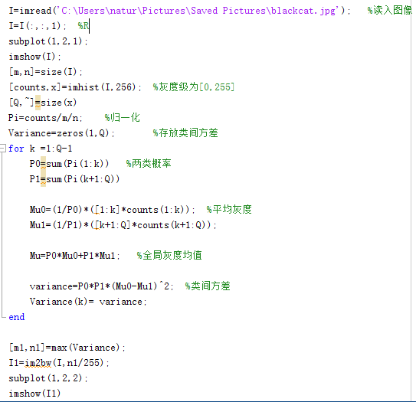
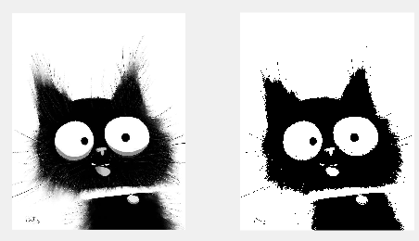
Code:

Slide 12
Understand a picture:
Classification: Structure an image into a certain category of information, and describe the image with a predetermined string or instance ID. The classification task cares about the whole and gives a description of the content of the entire picture.
Detection: Detection of a particular object target requires simultaneous acquisition of category information and location information for that target.
Segmentation: Segmentation includes semantic segmentation and instance segmentation. The former is an extension of the pre-background separation, which requires separation of image parts with different semantics, while the latter is an extension of the detection task, which requires describing the outline of the target ( More detailed than the detection frame). Segmentation is a pixel-level description of an image that gives each pixel category (instance) meaning for understanding the more demanding scenes.

Slide 13
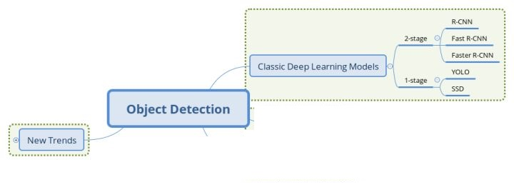
Target detection: Combination of image classification problem and location problem
Traditional target detection: Regional selection, extraction feature, classification regression
Now:

Slide 14
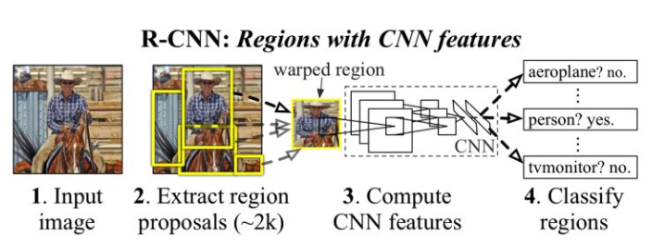
2-stage detection model: Two-knife solve the problem
Generate region proposal and CNN extracts features
Put in the classifier classification and correct the position
Development order:
R-CNN->SPP Net->Fast R-CNN->Faster R-CNN->Mask R-CNN
Generate candidate area re-detection first, reduce information redundancy

Slide 15
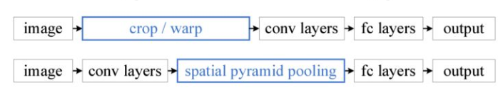
SPP Net:
Solution to R-CNN hard injury:
First: Computational redundancy
First generate candidate regions and then convolute-> First convolution and then generate region
Second: image crop/warp

Slide 16
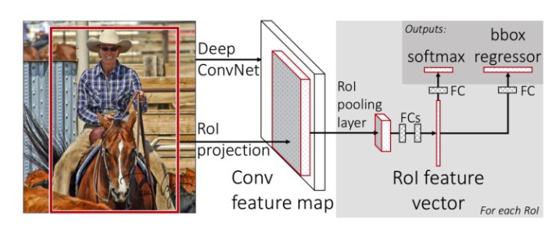
Fast R-CNN:
The original R-CNN first classifies the candidate frame areas to determine whether there are any objects, and if so, the Bounding Box is refined and regressed. This is a tandem task, so it is not fast in parallel, so rbg changes the original structure to parallel - in the classification, the Bbox is regression.

Slide 17
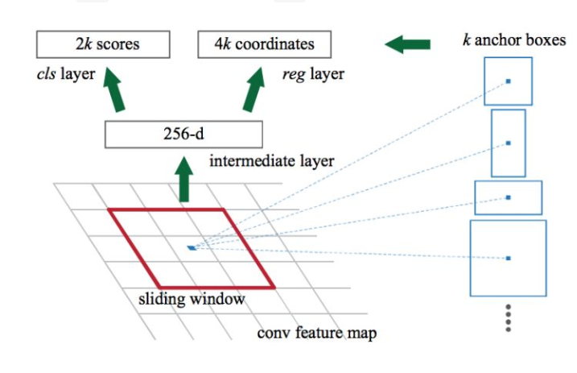
Faster R-CNN:
Use neural networks to learn to generate candidate regions.

Slide 18
Mask R-CNN:
Add another information input, ie the mask of the image
Not only can you do "target detection" but also "semantic segmentation" at the same time

Slide 19
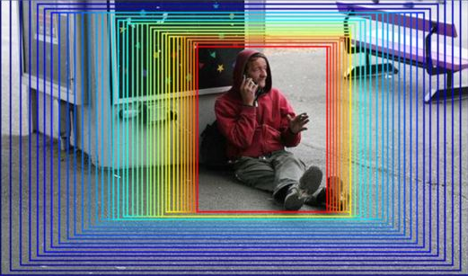
1-stage detection model: one-knife to solve the problem
Directly regress the predicted target object
The idea of ​​ one-knife flow is more violent. Given an image, use the regression method to output the border and category of the target. The core of one-knife flow is to use the excellent classification effect of the classifier. First, give a rough range (the first is the whole image) to classify, and then iterate this range until a fine position, as shown in the blue frame above. Go to the red box.

Slide 20
YOLO(You only look once):
Divide the input image into a grid of SxS, each grid responsible for detecting what the object inside the grid is and outputting Bbox Info and confidence. Confidence here refers to what objects are contained in the grid and the accuracy of predicting the object.
Each grid is processed using an algorithm that uses NMS (non-maximum suppression) to remove overlapping frames
IOU(Intersection over Union): Calculate the coincidence of two regions (two boxes)

Slide 21
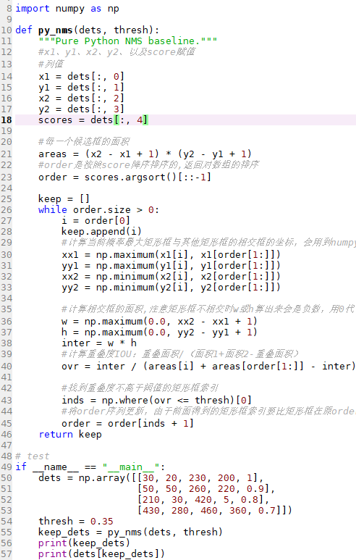
NMS(non-maximum suppression):
NMS algorithm process:
Sort according to the classification probability of the candidate box: A<B<C<D<E<F
1. Mark the maximum probability rectangle F is the one we want to keep
2. Starting from the maximum probability rectangle F, determine whether the overlap degree IOU of A~E and F (the intersection ratio of the two frames) is greater than a certain threshold, and assume that the overlap degree of B, D and F exceeds the threshold. Then throw away B, D
3. From the remaining rectangular frames A, C, and E, select the E with the highest probability, mark it as to be retained, then interpret the overlap between E and A, C, and discard the rectangular frame whose overlap exceeds the set threshold.

Slide 22
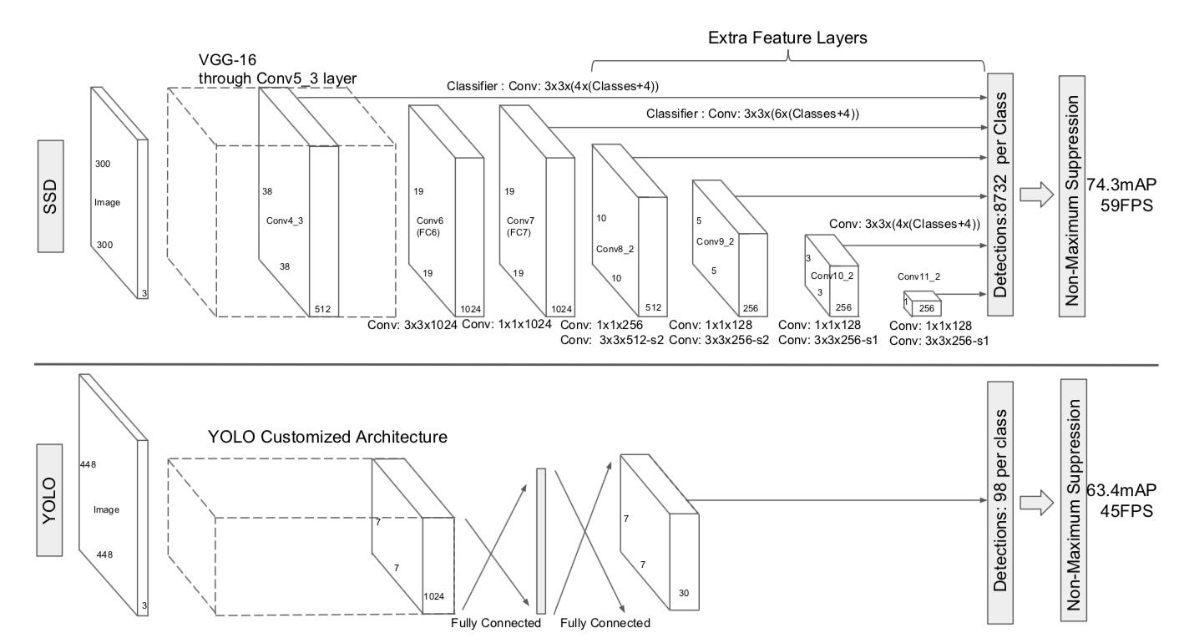
SSD(Single Shot MultiBox Detector): Improved detection of small objects
SSD added the Anchor concept of Faster R-CNN to YOLO's idea and combined the characteristics of different convolutional layers to make predictions.

Slide 23
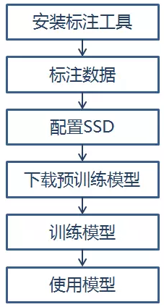
Building a target detection model(SSD)：
Install the annotation tool: First, make data annotations, that is, first tell the machine what objects are in the image, where are the objects in place?
Use VOC_2007 data format file to store in xml format
labelImg annotation tool
Annotate data: create file, annotate data, divide training set, test set, verification set
SDD Configuration: download SSD code, convert file format, modify object category

Slide 24
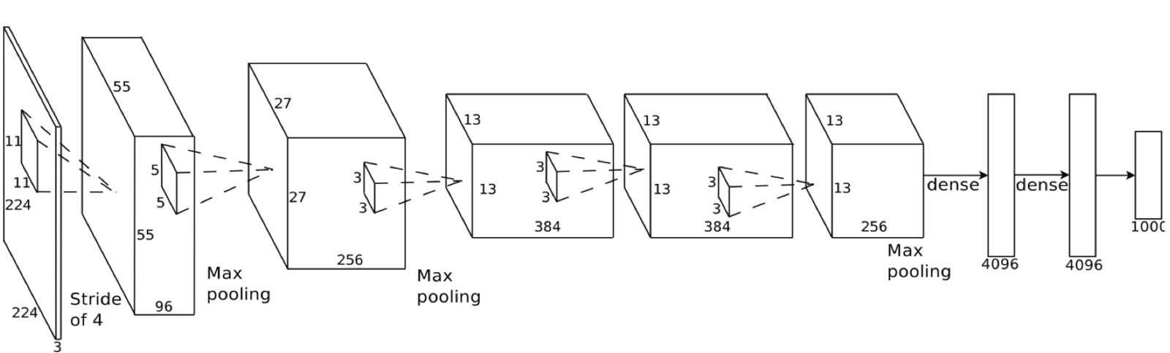
Image Recognition:
Neural network understands translation invariance: whether objects appear in different positions of the image or the same object——Convolution
Starting with a 224 × 224 pixel image, use two convolutions and maximum pooling first, then three convolutions, one maximum pooling; and finally two fully connected layers. The end result is that the image can be sorted into one of 1000 different categories.

Slide 25
Building a classifier:
Import tflearn
Load data set
Flip, rotate, and blur the images in the dataset to create some synthetic training data
Define network architecture:
Convolution
Max pooling
Convolution again
Convolution again
Max pooling again
Fully connected
Dropout: Randomly discard some data during training to prevent overfitting
Training neural network: through tflearn

Slide 26
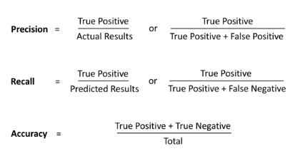
Evaluation:
 | Reality | Model predict
True Positives | Yes | Yes
True Negatives | No | No
False Positives | Yes | No
False Negatives | No | Yes
Need to know the probability of each error
Precision: The probability that the model is predicted to be true, is really true
Recall: refers to the percentage of total relevant results correctly classified by your algorithm

Slide 27
Image Classification: Label the input image with a fixed category
KNN
SVM
Migration learning
CNN

Slide 28

KNN(K Nearest Neighbors):
When predicting a new value x, determine which category x belongs to based on what category it is from the nearest K points.
K value selection:
Through cross-validation (split the sample data according to a certain proportion, split the training data and the verification data, such as splitting part of the training data and verification data in 6:4), starting from selecting a smaller K value, continuously Increase the value of K, then calculate the variance of the validation set, and finally find a suitable K value.

Slide 29
Disadvantage:
1. The classifier must store all training set data for comparison with future test data sets.
2. It is costly to compare the test set to all training sets.

Slide 30
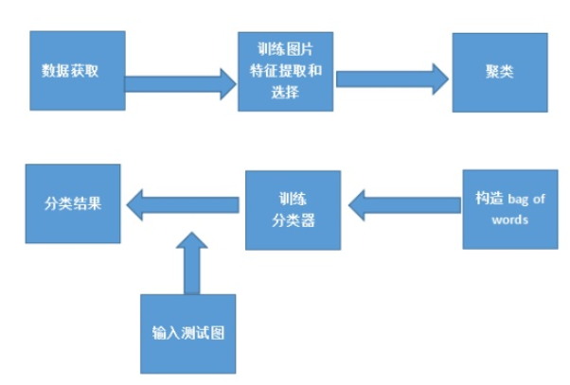
SVM(Support Vector Machines):

Slide 31
Transfer learning and CNN(Convolution neural networks):
Transfer learning: It is to migrate the learned model parameters to a new model to help the new model training.
CNN:
Convolution operation
Nonlinear activation function
Pooling layer
Fully connected layer
Neural network training and optimization

Slide 32
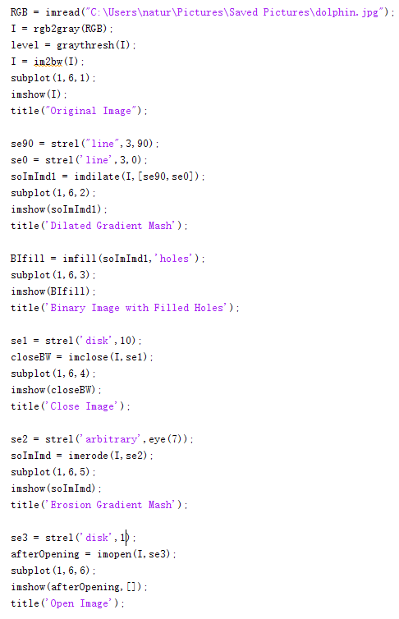
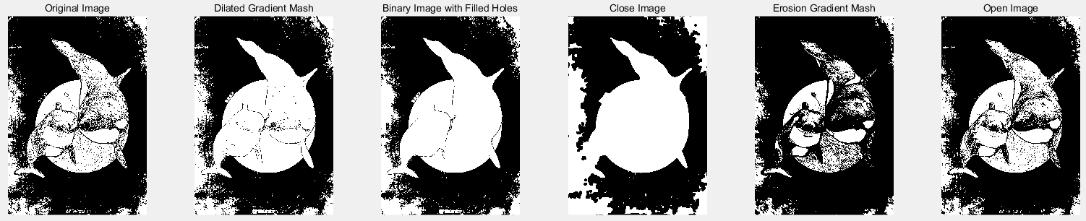
Dilation: extend the highlighted or white portion of the image Erosion: reduce the highlighted or white portion of the image

Slide 33
Common Image Datasets:
Imagenet:
COCO common objects:
Pascal VOC:
MNIST:
LFW:

Slide 34
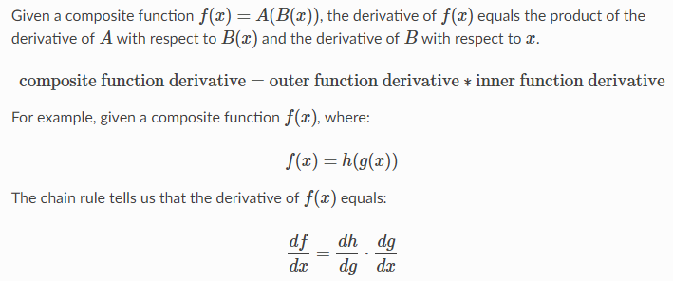
Chain rule: is a formula for calculating the derivatives of composite functions.
Each network layer (hidden layer and output layer) can be regarded as a function of fitting. For a multi-layer (depth) neural network, its mathematical essence is equivalent to a multi-layer composite function: It implements a mapping from vector x to vector y

Slide 35
Initialization:
In order for the neural network to learn useful information during the training process, this means that the parameter gradient should not be zero. And we know that in a fully connected neural network, the parameter gradient and the state gradient obtained by backpropagation are related to the activation value. Then the parameter initialization should meet the following two conditions:Initialization of the necessary conditions 1: the activation value of each layer will not appear saturated;Initialization prerequisite 2: The activation value of each layer is not 0.

Slide 36
Vanishing Gradient Problem:
Often appear in:
In the deep network
Use the inappropriate loss function
Deriving the activation function, if this part is less than 1, when the number of layers increases, the final gradient update will be reduced exponentially, that is, the gradient disappears.
Derivation of the activation function, if this part is greater than 1, then when the number of layers increases, the final gradient update will be exponentially increased, that is, a gradient explosion occurs.

Slide 37
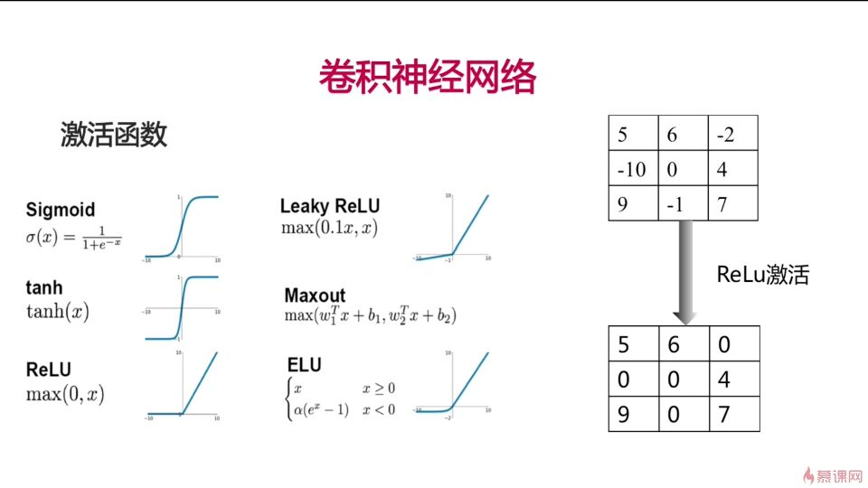

Slide 38
Loss Function: is used to estimate the degree of inconsistency between the predicted value f(x) of the model and the true value Y. The smaller the loss function, the better the robustness of the model is represented. It is the loss function that guides the model. Learn. Divided into regression and classification

